Slide 1
Web Browser
Web Client Interface.
Provides Interaction with Web Server through
Proxies (gateways through which requests and responses
pass between servers and clients to enhance
security and performance).

Slide 2
Main Responsibilities of a Browser
Generate and send requests to Web servers on the user’s behalf.
Accept responses delivered by Web servers and interpret them to produce the visual representation to be viewed by the user.
Render the results in the browser window or through a third party tool, depending on the content type of the response.
Basic Tasks: Caching, Authentication, State maintenance, dealing with errors etc.

Slide 3
ARCHITECTURAL CONSIDERATIONS:
Browser Architectural means:
putting together requirements for the architecture of a Web browser.
What are those requirements?
What functions must a Web browser perform?
how do different functional components interact with each other?
The following list describes the core functions associated with a Web browser.
Each function can be thought of as a distinct module within the browser, must communicate with each other in order to allow the browser to function.

Slide 4
ARCHITECTURAL CONSIDERATIONS:
User Interface: This module provides a working area through which users interact with the application. This includes presenting, displaying, and rendering the end result of the browser’s processing of the response transmitted by the server.
Request Generation: This module bears responsibility for the task of building HTTP requests to be submitted to HTTP servers.
Response Processing: this module must parse the response, interpret it, and pass the result to the User Interface module.

Slide 5
ARCHITECTURAL CONSIDERATIONS:
4. Networking: this module is responsible for network communications. It takes requests passed to it by the Request Generation module and transmits them over the network to the appropriate Web server or proxy. It also accepts responses that arrive over the network and passes them to the Response Processing module.
5. Content Interpretation: After receiving the response, the Response Processing module needs help in parsing and deciphering(decoding) the content. The content may be encoded, and this module is responding to decode it.

Slide 6
ARCHITECTURAL CONSIDERATIONS:
6. Caching: Avoiding the unnecessary retrieval of resources that the browser already has a usable copy of, ‘cached’ away in local storage. Browsers can ask Web servers whether a desired resource has been modified since the time that the browser initially retrieved it and stored it in the cache.
7. State Maintenance: since HTTP is a stateless protocol, some mechanism must be in place to maintain the browser state between related requests and responses. Cookies are the mechanism of choice for performing this task.

Slide 7
ARCHITECTURAL CONSIDERATIONS:
Authentication: this module takes care of composing authorization credentials (certificates) when requested by the server.
It must interpret response headers demanding credentials by prompting the user to enter them (usually via a dialog).
It must also store those credentials, but only for the duration of the current browser session.
9. Configuration: finally, there are a number of configuration options that a browser application needs to support. Some of these are fixed, while others are user definable.

Slide 8
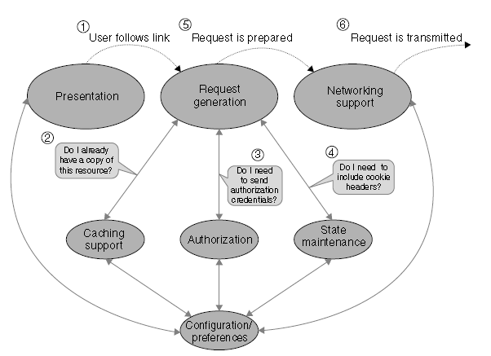
PROCESSING FLOW
Figure shows the processing flow for the creation and transmission of a request in a typical browser.

Slide 9
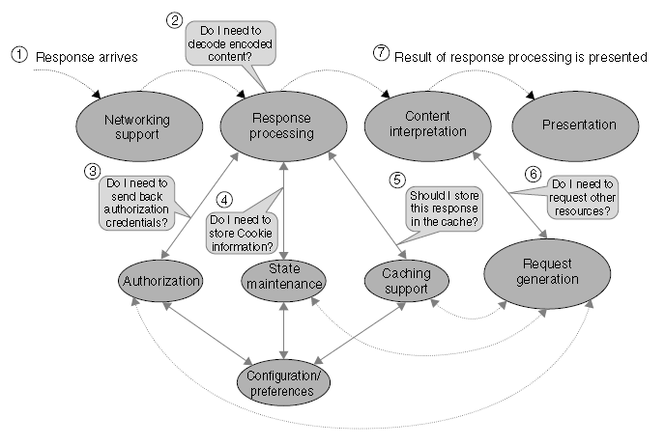
Browser Response Processing

Slide 10
COMPLEX HTTP INTERACTIONS
Now that we covered the basics of request and response processing, let us move on to situations where the interplay of requests and responses yields more sophisticated functionality. The areas we mentioned earlier were
caching, authorization, cookies, the request of supporting data items, and the processing of other complex response headers
(01) Caching:

